Slide 1
Weekly updates - 08/09/2021 - AI Institute
Progress made last week
- Reviewed 130 reports file, and revised relationship diagram
- Reviewed Material Master User manual documentation
- Brainstormed Shawn’s meeting notes, Questions, video
Plan for this week
- Continue to review the Zgrve and 130 reports and working to understand the header definitions
-Study Material Master User Manual documentation
- Identify important fields for Material Planning
- Prepare data dictionary to create database Improve relationship diagram

Slide 2
MRP #
Vendor Name
Vendor #
Traffic
Signal
Material
Planner
has
1..*
Supplier
(Vendor)
Model
Name
recommend
Models
Responsible
supply
1..*
Conditions
Material
Planning
Used in
1..*
1..*
triggers
has
use
Material
(Parts)
use
1..*
StckDS*
Exception
Stock Inventory
1..*
1st RDS*
StckDS - Stock Days’ Supply currently at plant (in Days)
Code #
desc.
RDS - inventory in transit from a supplier to BMW (in Days)
2nd
RDS*

Slide 3
Questions...
What is the current approach at BMW to perform material planning (other than stckDS, Exception message)?
How would a material planner like to receive a recommandations from Material Planner Assistant?
What will be a format of recommendations from Material Planner?
Are Colored Alerts sufficient for material planner?
Would it be possible to access historical exceptions datasets (along with material data) to analyze the frequency/occurrences of them? They may help us to analyze the frequently occur exceptions and root cause of them?
Is there any criticality level (or weight) associated with exception? For instance, it may be possible that some exceptions require more attention than other exceptions?

Slide 4
Traffic Signal
Signals | Description
Red | Require an immediate attention.
Yellow | Situations to be monitored but not critical
Green | There is no exception message and no issues.

Slide 5
MRP number
Vendor name
Method/Procedure/Algo
Vendor number
has
1..*
Supplier
(Vendor)
Material
Planner
Model
Name
Responsible
Models
Safety Stock Qty.
Stock
Qty.
1..*
Planned
Delivery Time
supply
Used in
Material
Planning
has
use
1..*
Plan
Qty.
MRP
Area
determine
Scrap
Material
1..*
Lot Size
procedure
1..*
Material
Number
Source of Material (MRP)
Net Price
Material Planning Method (Typ.)
ABC Indicator
Desc..

Slide 6
MRP number
Vendor name
Method/Procedure/Algo
Vendor number
has
1..*
Supplier
(Vendor)
Material
Planner
Model
Name
Responsible
Models
Safety Stock Qty.
Stock
Qty.
1..*
Planned
Delivery Time
supply
Used in
Material
Planning
has
use
1..*
Plan
Qty.
MRP
Area
determine
Scrap
Material
1..*
Lot Size
procedure
1..*
Material
Number
Source of Material (MRP)
Net Price
Material Planning Method (Typ.)
ABC Indicator
Desc..

Slide 7
Relationship Diagram (Zgrve)
Supplier # (Vendor #)
Supplier
Bill of lading
Status
Diff. Quantity
Original GR
Makes
Delivery Note #
Description
ASN Number
Trailer / Sea Container ID
Delivery
Contains
Material
Material #
Purchase Order #
Cur Unl
To
Curr GR
To and From
Movement Type
Factory
GR date and document #
User ID and Comment
Ver. Date

Slide 8
Questions...
What is the current approach/practise at BMW to perform material planning?
Can we have an example/case study to perform material planning?
Does a Material planner use any algorithm/procedure to perform Material planning?
What are the important columns (or fields) in 130 Report and Zgrve folder for Material Planning? (inputs of AI Material Planner Assistant)
How would a material planner like to receive a recommandations from AI Material Planner Assistant? (Output of AI Material Planner)
What will be a format of recommendations from AI Material Planner Assistant?
Are Colored Alerts sufficient for material planner assistant?
What is the criticality weight of each exception?
For instance, it may be possible that some exceptions have more weight than other exceptions?
How can we have better insight on historical data regarding the exceptions and material?

Slide 9
Question related to Datasets
130_Report_DDMM file contains two columns with the same name, “Material”. What does each column indicate? What is the relationship between these two columns
Is there any relationship between MRP and “Area” column?

Slide 10
Data Dictionary

Slide 11
Column Name | Column Type | Description
Safety Stk | Number (Int) | It specifies the quantity whose purpose is to satisfy unexpectedly high demand.
Stock | Number (Int) | It specifies the quantity - Valued stock with unrestricted use.
Plan Qty | Number (Int) | It specifies the planned quantity for consumption
Net Price | Number (Float) | It specifies the price of a material.
MRPCn | Text | It specifies an alphanumeric key of the MRP controller responsible for material planning for the material.
Vendor | Text | It specifies an alphanumeric key that uniquely identify the vendor in the system. It is also be called supplied number.
Material | Text | It is an alphanumeric key uniquely identifying the material
Material Description | Text | It is a text that describe the material in more detail.
Used in Models | Text | It is a text, containing a list of models (separated by commas) in which the material is used.

Slide 12
MRPCn
It specifies the number of the MRP controller or group responsible for material planning for the material.

Slide 13
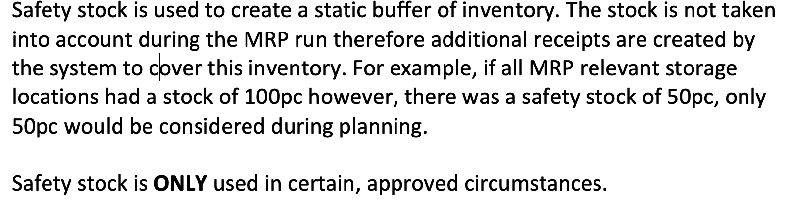
Safety Stk (Safety Stock)
It species the quantity whose purpose is to satisfy unexpectedly high demand in the coverage period.
The risk of shortfalls is reduced by having a safety stock.

Slide 14
Stock
Valued Stock with Unrestricted use

Slide 15
Plan Qty
Planned Quantity for consumption

Slide 16
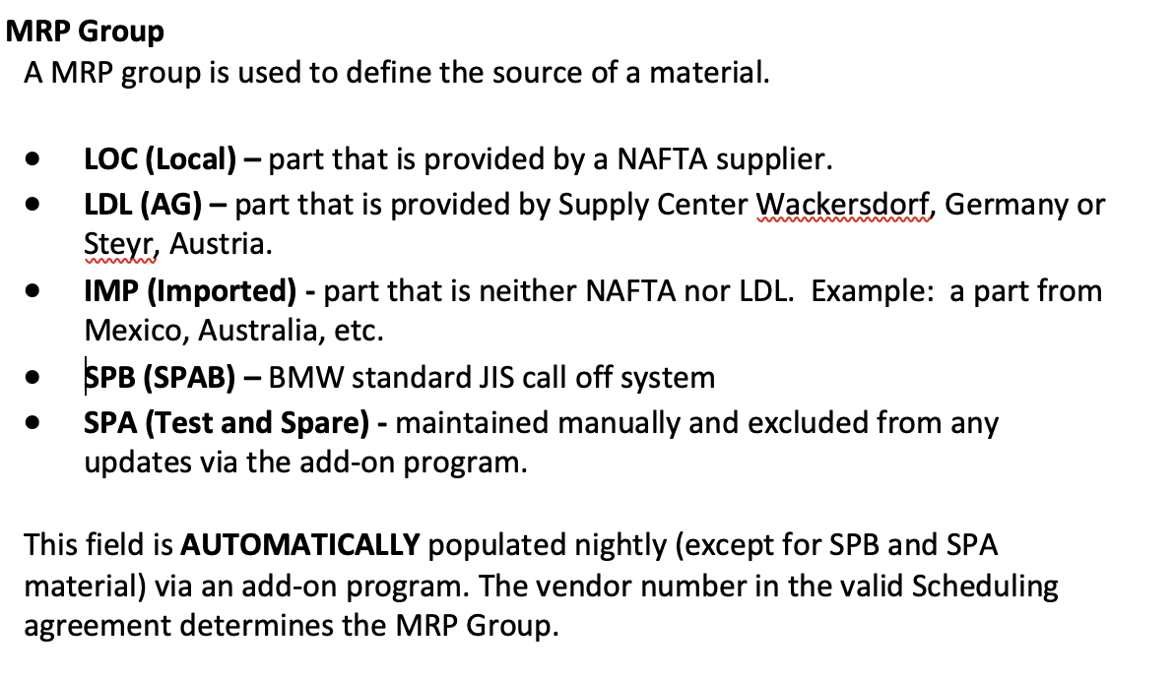
MRP (Source of Material)

Slide 17
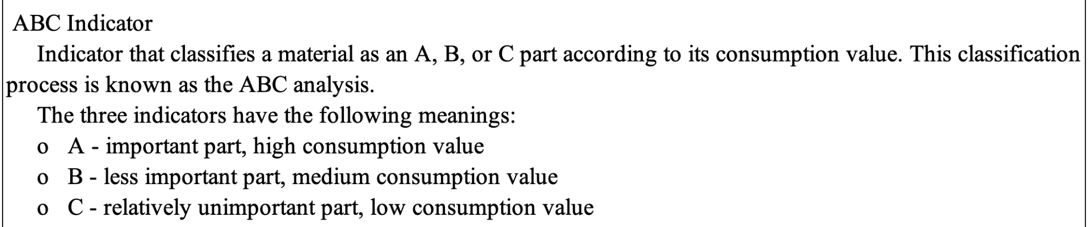
ABC indicator
The material is classified as an A, B, or C part according to its value and total requirements for a given period.

Slide 18
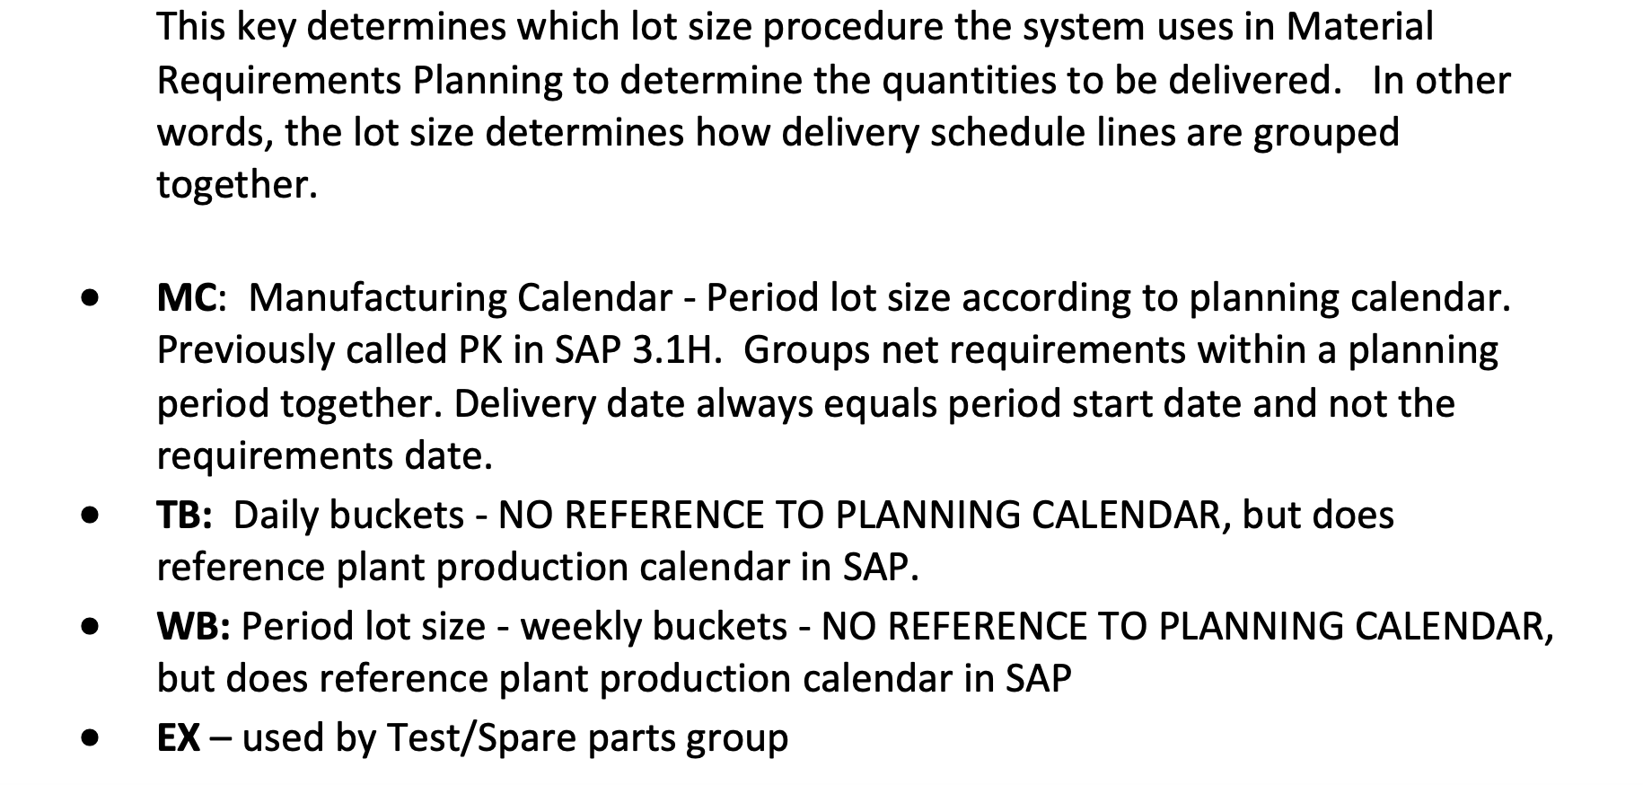
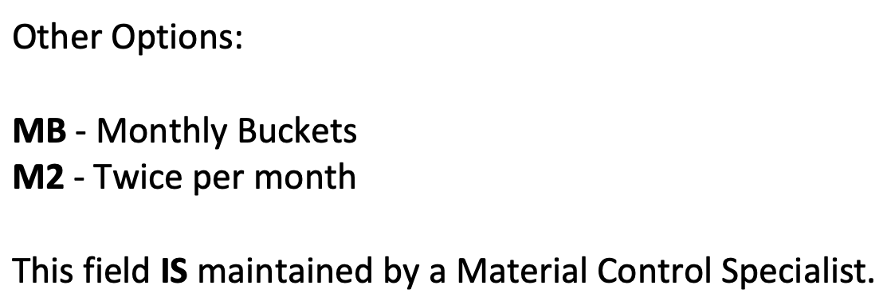
Lot Size (LS)

Slide 19
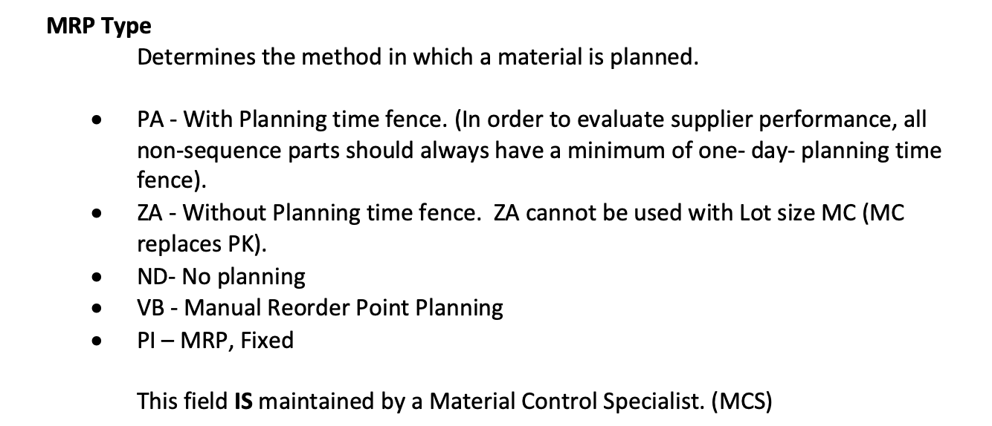
MRP Type (Typ)???

